Slide 1

FAKE NEWS ANALYSIS IN SOCIAL MEDIA USING
IBM WATSON

Slide 2


TEAM MEMBERS
J.Sahith reddy (18UK1A05D8)
K.Vishwasri (18UK1A05E3)
C.Vyshnavi (18UK1A05C8)
K.Anil Kumar (18UK1A0580)

Slide 3
CONTENTS
Abstract
Introduction
Problem Definitions
Motivation
Design of the project
Hardware and Software designing
NLP classifier Model
Conclusion
Result

Slide 4
ABSTRACT
Social media for news consumption is a double-edged sword. On the one hand, its low cost, easy access, and rapid dissemination of information lead people to seek out and consume news from social media. On the other hand, it enables the wide spread of "fake news", i.e., low quality news with intentionally false information. The extensive spread of fake news has the potential for extremely negative impacts on individuals and society. Therefore, fake news detection on social media has recently become an emerging research that is attracting tremendous attention. Fake news detection on social media presents unique characteristics and challenges that make existing detection algorithms from traditional news media ineffective or not applicable. First, fake news is intentionally written to mislead readers to believe false information, which makes it difficult and nontrivial to detect based on news content; therefore, we need to include auxiliary information, such as user social engagements on social media, to help make a determination. Second, exploiting this auxiliary information is challenging in and of itself as users' social engagements with fake news produce data that is big, incomplete, unstructured, and noisy. Because the issue of fake news detection on social media is both challenging and relevant, we conducted this survey to further facilitate research on the problem. In this survey, we present a comprehensive review of detecting fake news on social media, including fake news characterizations on psychology and social theories, existing algorithms from a data mining perspective, evaluation metrics and representative datasets. We also discuss related research areas, open problems, and future research directions for fake news detection on social media

Slide 5
INTRODUCTION
Nowadays, fake news has become a common trend. Even trusted media houses are known to spread fake news and are losing their credibility. So, how can we trust any news to be real or fake? There should be a system which can analyse whether a given news post is fake or not . so the main of this project is to build an application that can analyse fake news In this project, we have built a classifier model that can identify news as real or fake. For this purpose, we have used data from Kaggle, but you can use any data to build this model following the same methods.With the help of this project you can create an NLP classifier to detect whether the news is real or fake. There is a paradigm shift in how people consume news today. They mostly look for a summarized version of news over the social media platforms to quickly gather more information . This change is due to easy access to news readily available over social media platforms like Twitter and Facebook. The study's findings concluded that social media, mostly micro blogging platforms, were the most significant contributor to spread false information.
The extensive spread of fake news has the potential for extremely negative impacts on individuals and society. Therefore, fake news detection on social media has recently become an emerging research that is attracting tremendous attention. Fake news detection on social media presents unique characteristics and challenges that make existing detection algorithms from traditional news media.

Slide 6
Problem Definitions
Fake news has existed for a very long time, nearly the same amount of time as news began to circulate widely after the printing press was invented in 1439. However, there is no agreed deﬁnition of the term “fake news”. Therefore, we ﬁrst discuss and compare some widely used deﬁnitions of fake news in the existing literature, and provide our deﬁnition of fake news that will be used for the remainder of this survey .A narrow deﬁnition of fake news is news articles that are intentionally and veriﬁably false and could mislead readers [2].There are two key features of this deﬁnition: authenticity and intent. First, fake news includes false information that can be veriﬁed as such. Second, fake news is created with dishonest intention to mislead consumers. This deﬁnition has been widely adopted in recent studies .
Broader deﬁnitions of fake news focus on the either authenticity or intent of the news content. Some papers regard satire news as fake news since the contents are false even though satire is often entertainment-oriented and reveals its own deceptiveness to the consumers . Other literature directly treats deceptive news as fake news, which includes serious fabrications, hoaxes, and satires.

Slide 7
Motivation
The project aims to predict fake news analysis in social media using IBM Watson.
In this project we predict whether the news is real or fake. we present the
details of mathematical formulation of fake news detection on social
media.

Slide 8
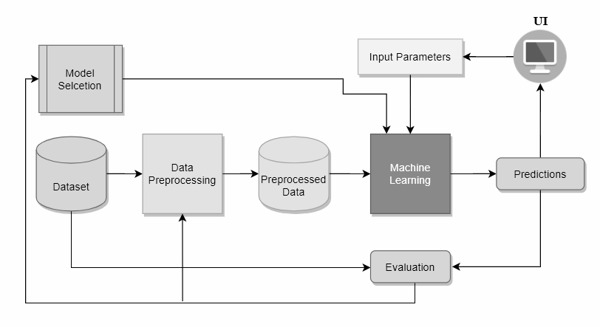
Design of the project

Slide 9
Hardware and software designing
This project involves the following software tools
Vs code
Anaconda
Jupyter Ide
NLP Classifier(Natural language processing)
IBM Watson

Slide 10
NLP Classifier and TF-IDF
Attempts to use artificial intelligence technology specifically machine learning techique natural language processing ,to automatic detect fake news and stop it from spreading fake news which we have recently been discussed
It can be possible to teach a computer how to detect and understand the difference between real news and fake news using natural language processing(NLP)
TF-IDF denotes to term frequency and inverse document frequency
In data mining and data recovery, the TFIDF weight is commonly used
TFIDF may be used to separate stop-words in a varity of subject and such as text summarization and classification

Slide 11
Conclusion
The task of classifying news manually requires in-depth knowledge of the domain and expertise to identify anomalies in the text. In this research, we discussed the problem of classifying fake news articles using machine learning models and ensemble techniques. The data we used in our work is collected from the World Wide Web and contains news articles from various domains to cover most of the news rather than specifically classifying political news. The primary aim of the research is to identify patterns in text that differentiate fake articles from true news. We extracted different textual features from the articles using an LIWC tool and used the feature set as an input to the models. The learning models were trained and parameter-tuned to obtain optimal accuracy. Some models have achieved comparatively higher accuracy than others. We used multiple performance metrics to compare the results for each algorithm. The ensemble learners have shown an overall better score on all performance metrics as compared to the individual learners.

Slide 12
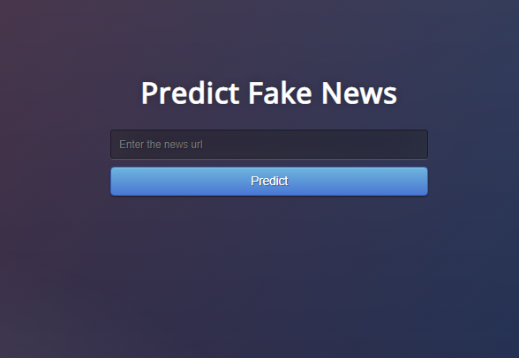
Result

